Slide 1

California Wildfire in years from 2005-2015
Group Name: Breaking Bad
Presentation speaker: Jade
Other Group members: Jiaqi, Renqi, Tianliang

Slide 2
Page Design
Home Page
Choropleth Map Page
Pie Chart Page
Heat Map Page
Design and Implementation, What we compromise

Slide 3
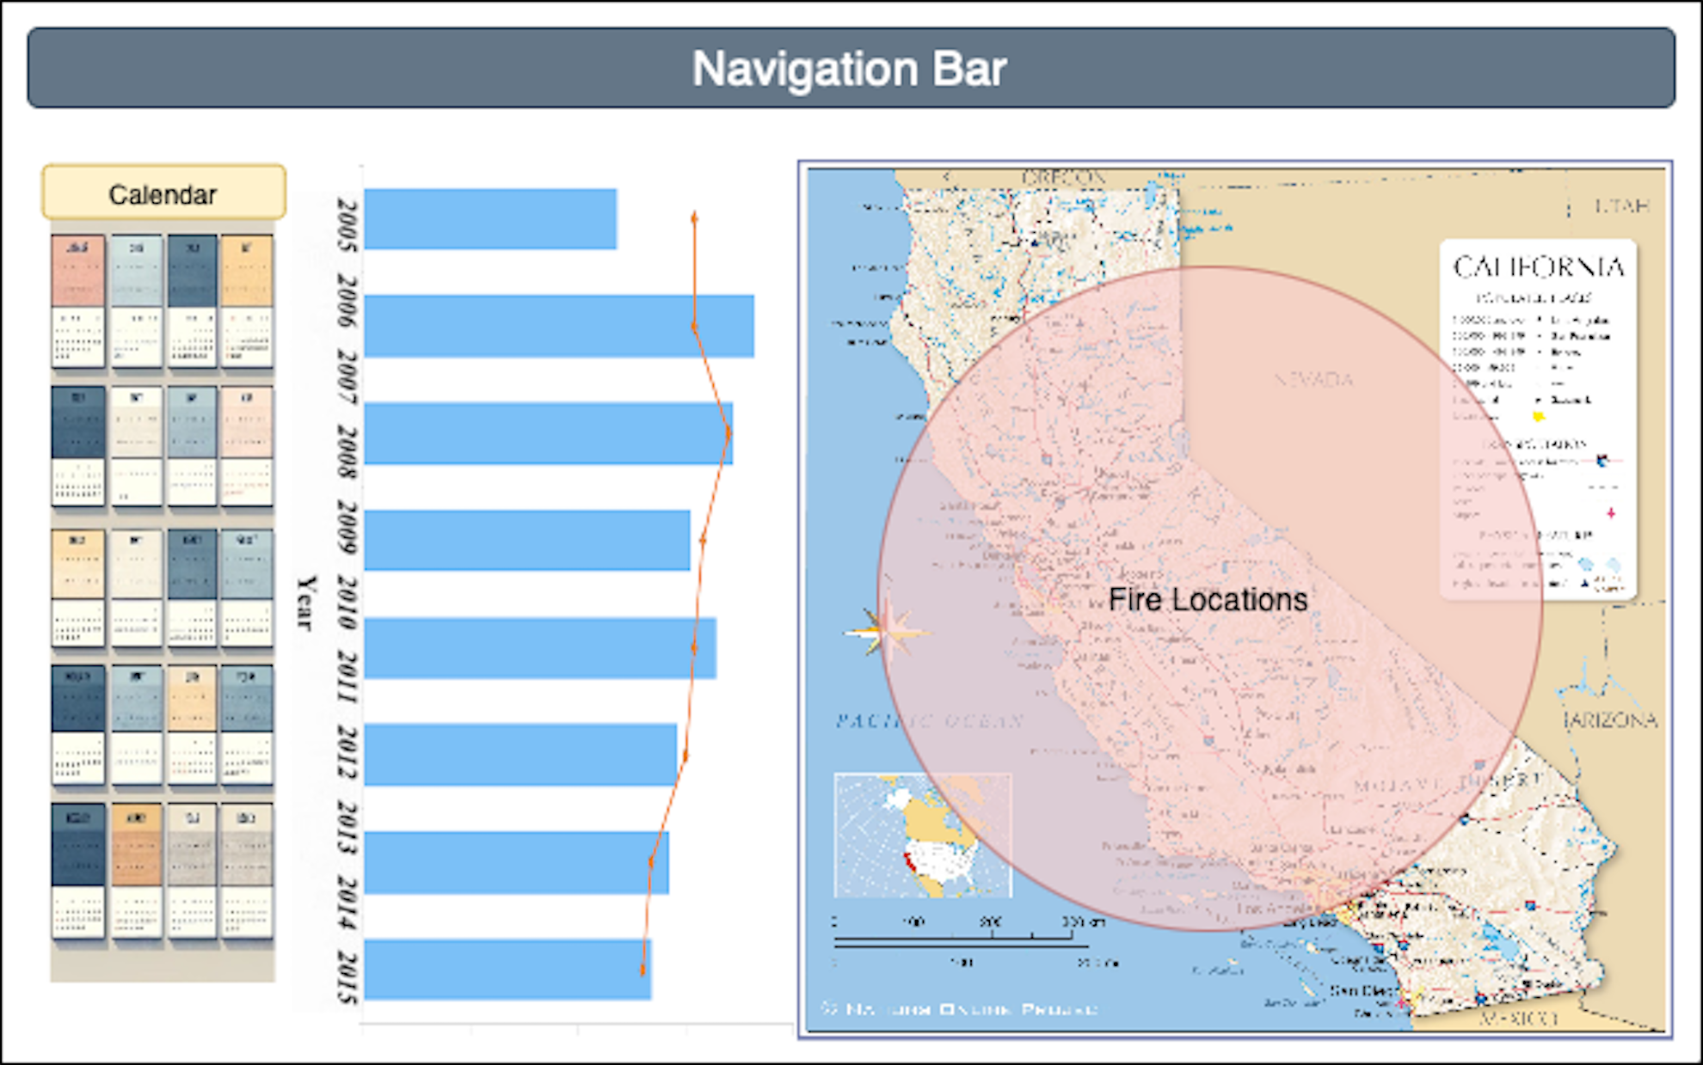
Design Phase: Home Page Layout Design

Slide 4
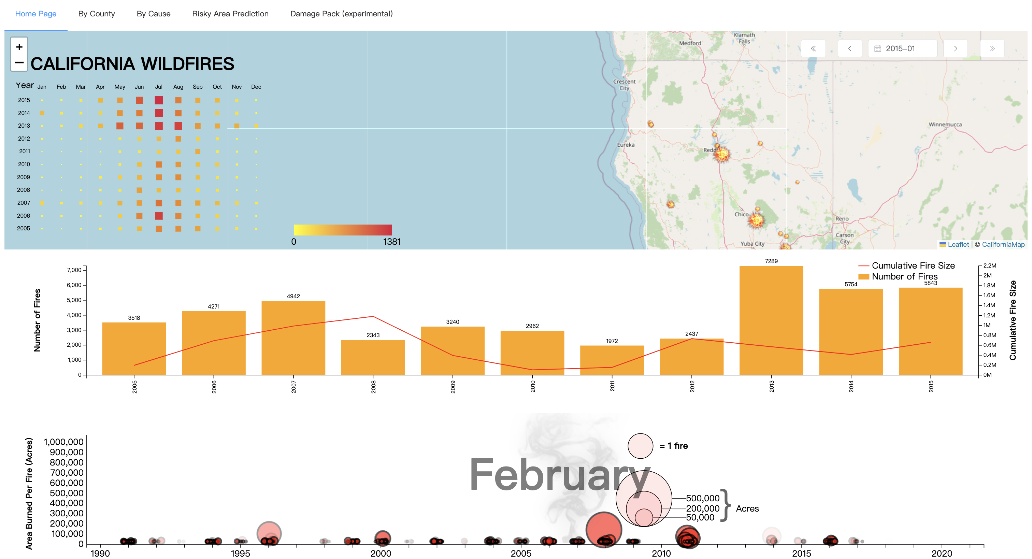
Finished Result: Home Page

Slide 5
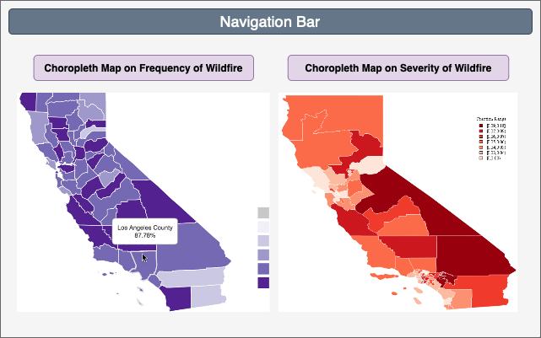
Design Phase: Choropleth Map Page Layout Design

Slide 6
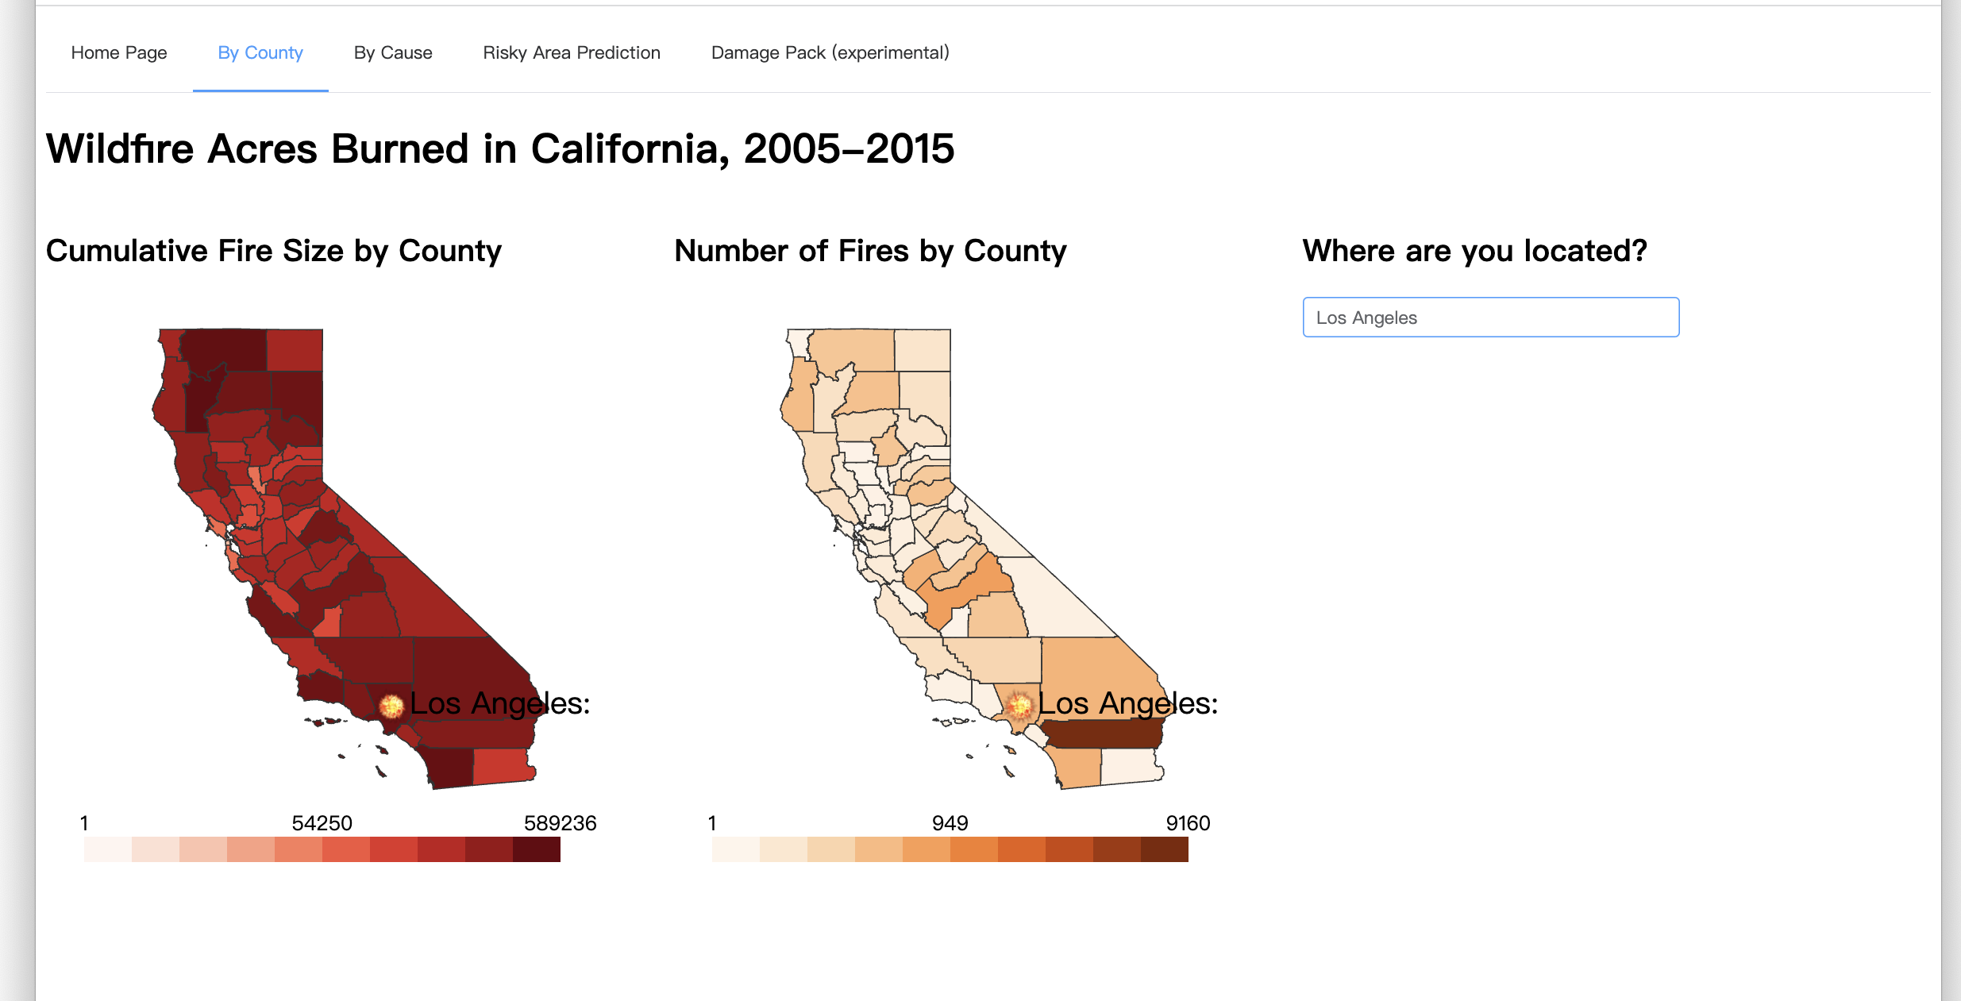
Design Phase: Choropleth Map of Wild Fire in County Level

Slide 7
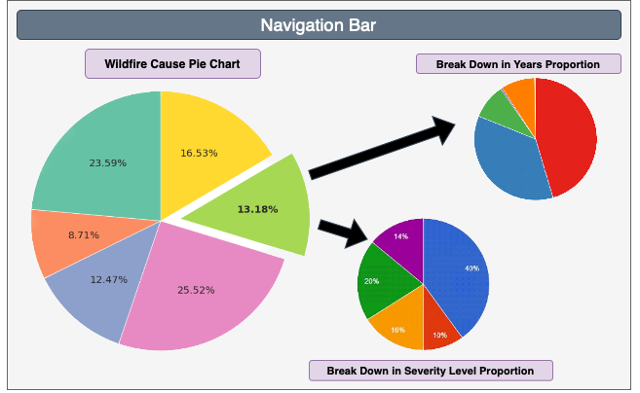
Design Phase: Pie Chart Page Layout Design

Slide 8
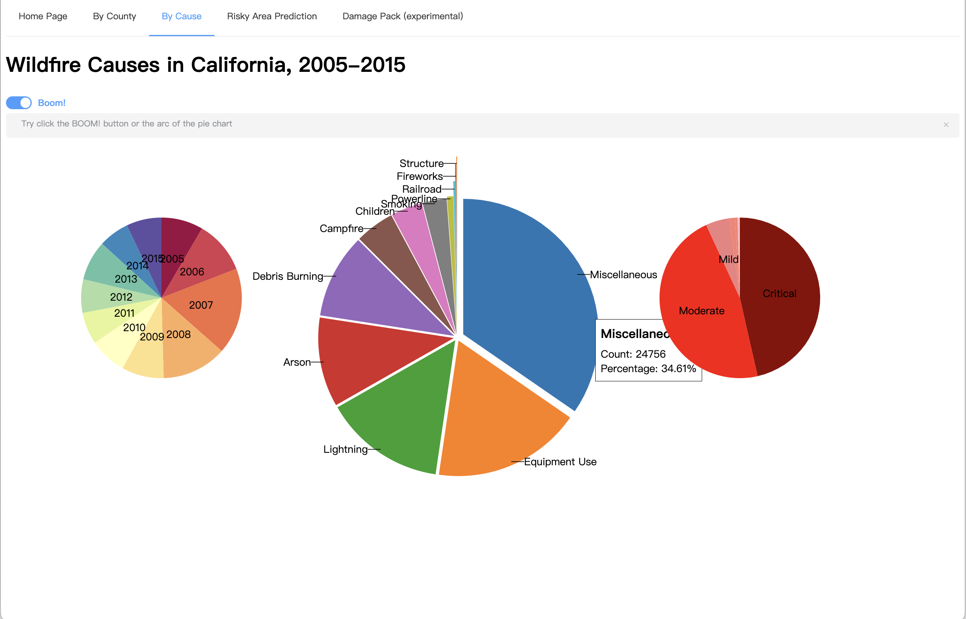
Finished Result: Page for Pie Chart of Wild Fire Info Break down in Cause

Slide 9
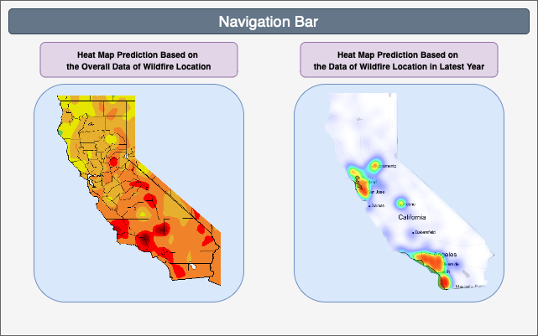
Design Phase: Risk Prediction Heat Map Page Layout Design

Slide 10
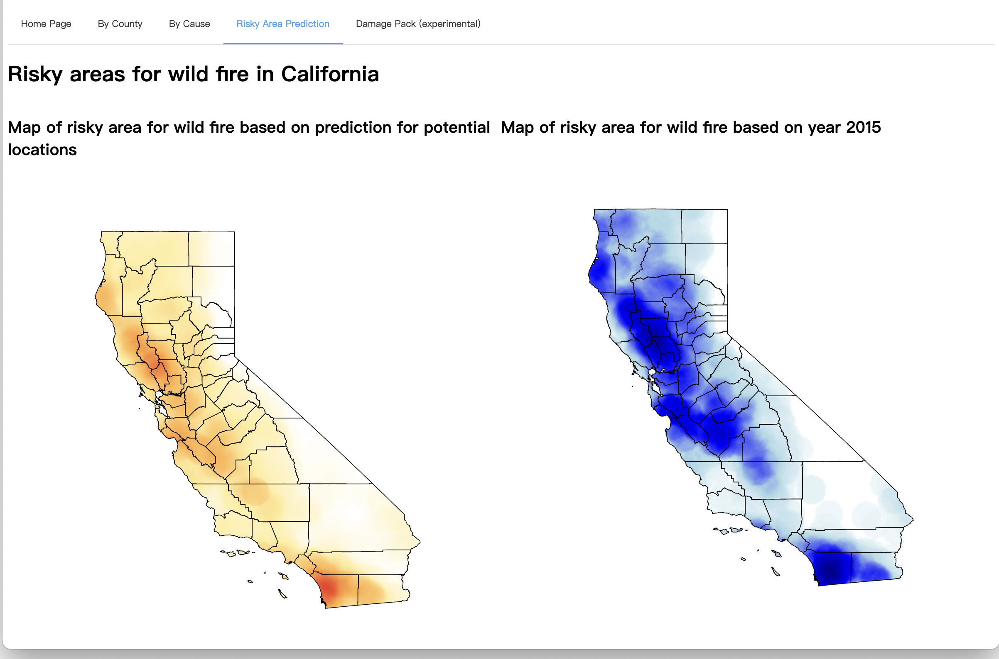
Finished Result: Risk Prediction Heat Map Page

Slide 11
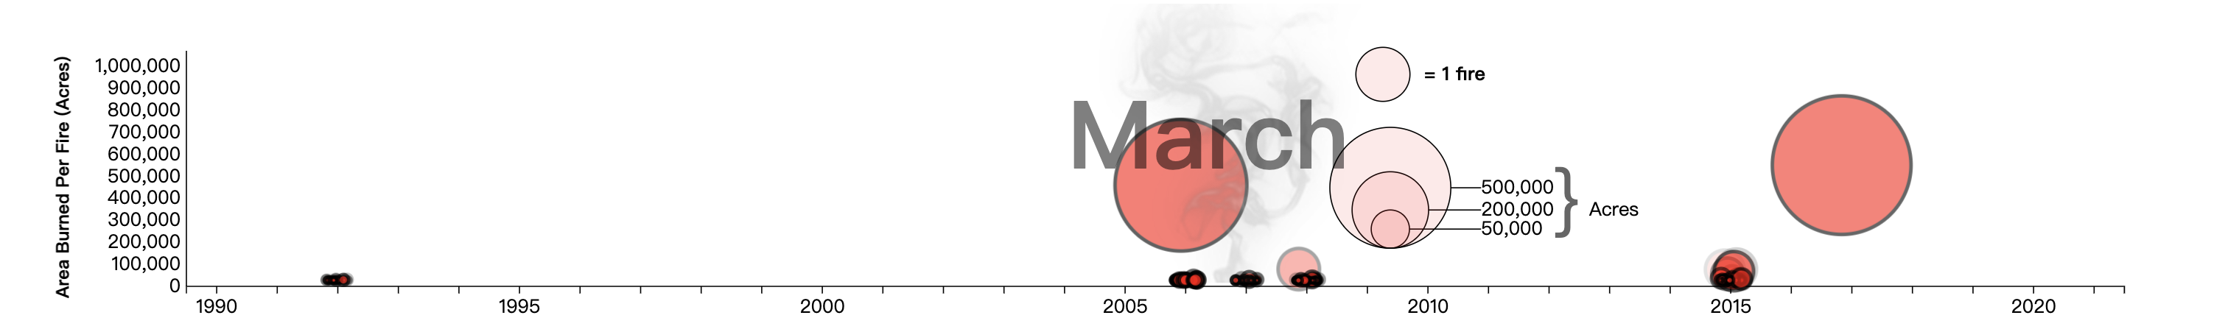
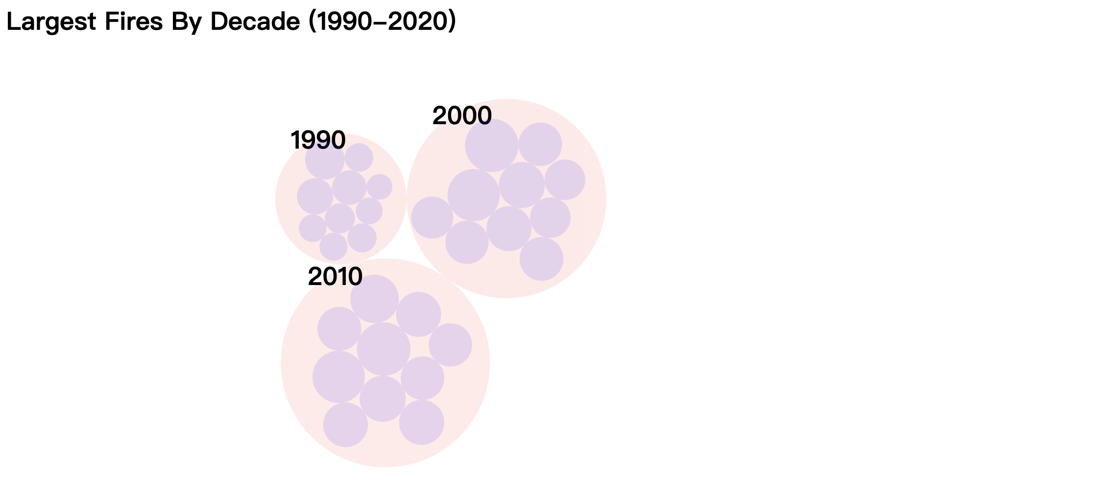
Finished Result: Experimental Features

Slide 12
Developing Strategies
Git Group Development
Using Vue to Divide Pages into Components
Python Scripts Data Pre-processing

Slide 13
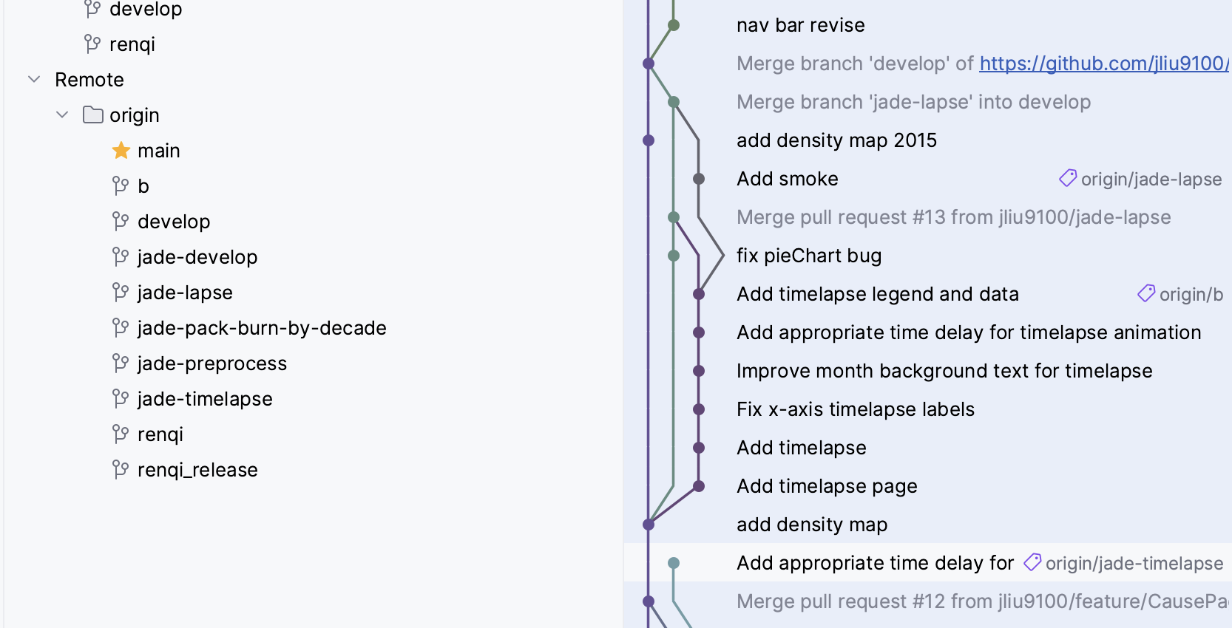
Git Group Developing Strategy

Slide 14
Navigation Bar
Component
Map Component
Vue Components

Slide 15
Thanks For Watching!

